Slide 1

#LifeKoKaroLift
Data Science Certification Program

Slide 2


Course : Data Science
Lecture On : Numpy indexing
Instructor : Shivani Kapania

Slide 3
In Last Class, we covered….
Create Numpy arrays
Convert lists and tuples to NumPy arrays
Create (initialise) arrays
Inspect the structure and content of arrays
Understand advantages of using vectorized code using Numpy

Slide 4
Today’s Agenda
Subset, slice, index and iterate through arrays
Multidimensional arrays

Slide 5
Numpy slicing: 1D arrays
The basic object in NumPy is the ndarray, or simply an array, which is an n-dimensional, homogenous array.
For one-dimensional arrays, indexing, slicing etc. is similar to python lists - indexing starts at 0.

Slide 6
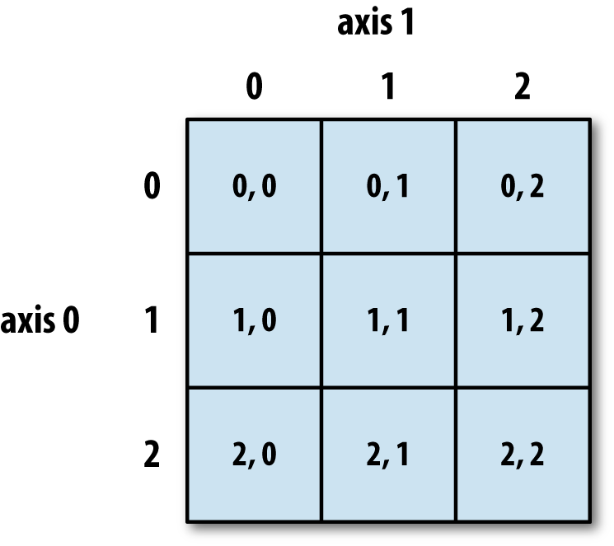
Numpy slicing: Multidimensional arrays
Multidimensional arrays are indexed using as many indices as the number of dimensions or axes. For instance, to index a 2-D array, you need two indices - array[x, y].
Each axes has an index starting at 0. The following figure shows the axes and their indices for a 2-D array.

Slide 7
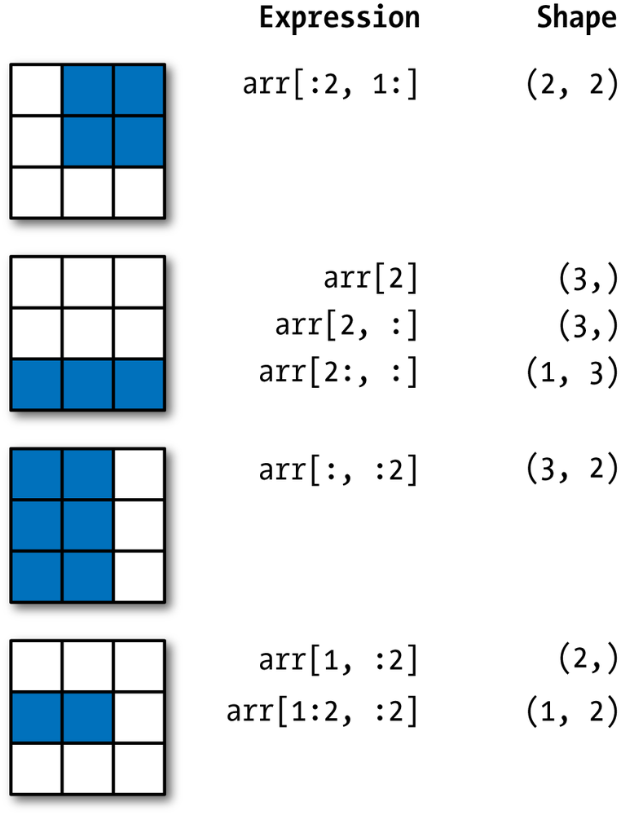
2d array slicing

Slide 8
Creating Numpy arrays
np.array()
Numpy array from list
Numpy array from tuple
Initialize array of fixed size
np.ones()
np.zeros()
np.random.random()
np.arange()
np.linspace()

Slide 9
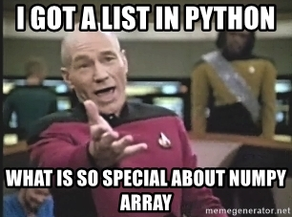
WHY NUMPY?
Numpy
Vectorization
Broadcasting
Indexing

Slide 10
WHY NUMPY?
Vectorization
Practice of replacing explicit loops with array expressions.
Broadcasting
For arrays with different shapes.
Indexing
Basic indexing
Advanced indexing
Express operations as occurring on entire arrays rather than their individual elements.
The smaller array is “broadcast” across the larger array so that they have compatible shapes.

Slide 11
#LifeKoKaroLift
Thank You!

